Slide 1
Car Rental System TEAM JERM
GROUP MEMBERS
Jebin taSNIM (Id:14.01.04.056)
Redwanul Ferdous (Id:14.01.04.058)
Muntasir mamoor eftee (id:14.01.04.072)
Fatin nur anik (id:14.01.04.073)

Slide 2
Objectives of Information Gathering and Interview
To identify the requirements of the users.
To find and clarify necessary facts regarding users requirements.
To gather information from owners of a rent a car company about their service.
To gather information about how tourists/customers want to see a car rental system website.

Slide 3
Questionnaires and Interview Pattern
Questions to owner of rent a car company.
Questions to the tourist/customer.
Face to face.
Diamond structured questions.
Close-ended questions.
Open-ended questions.

Slide 4
Selection of Interview Personnel
Mr. Shahriar , the owner of the CHETONA rent a car company.
Reason of selection :
To gather necessary information about his comapany and services.
To know his view over car rental system and websites.
His thoughts on online renting system of the country.
To know about the trustable security they provide.
As a company owner, how he wants to see a car rental system website.

Slide 5
Place of Survey
Ahsanullah university of science and technology.
A rent a car company of Dhaka City.
Online through Facebook.
Websites and pages of different rent a car company.

Slide 6
Participants of Survey
Students of AUST.
Some tourists and customers.
Owner of a rent a car company.
Friends and family of our facebook.

Slide 7
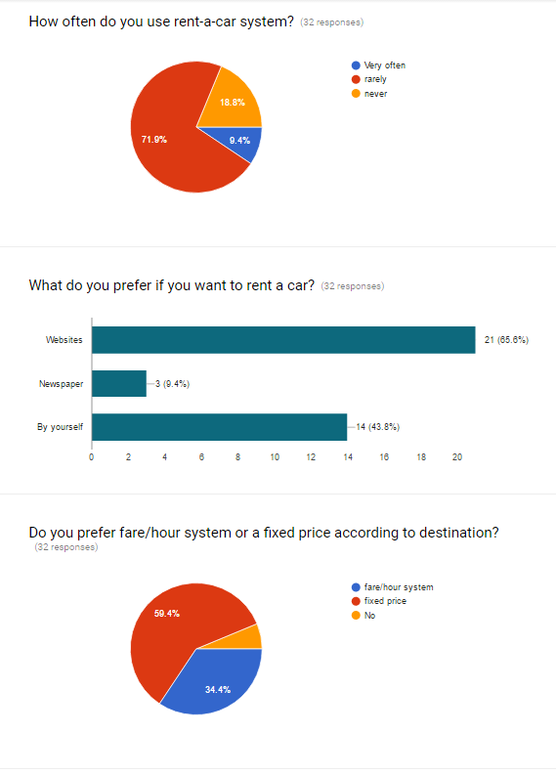
Questions and Answers of survey in form of Pie chart

Slide 8
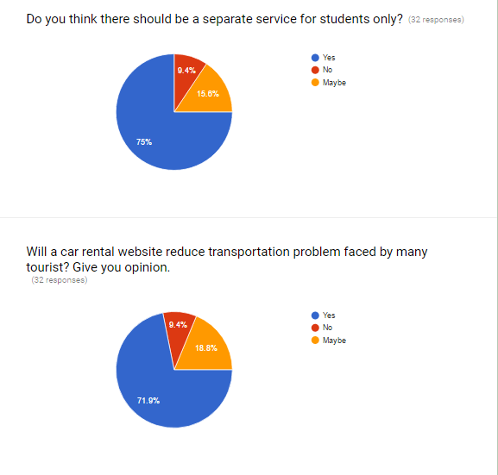
Questions and Answers of survey in form of Pie chart

Slide 9
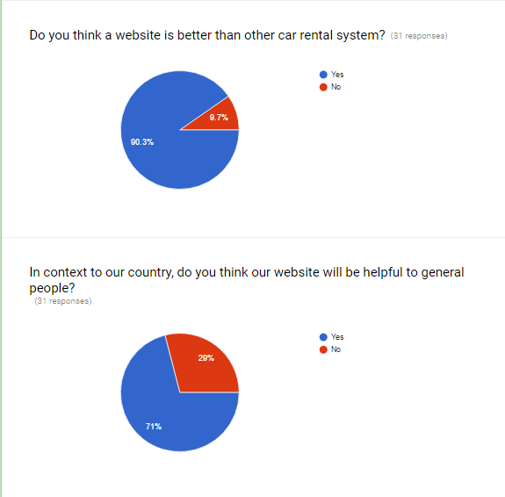
Questions and Answers of survey in form of Pie chart

Slide 10
Survey Analysis
71.9% of people use rent a car very often.
65.6% of people prefer websites for renting a car.
59.4% of people fare/hour system according to destination.
75% of people wants a separate feature for them.
71.9% of people think that a rent a car system website will reduce transportation problem they face.

Slide 11
Survey Analysis
While renting a car online cash on delivery payment method is preferable to 74% of people.
71% of people think that our website will be helpful for general people in context to our country.
About 90.3% of people think that a website is a better system for renting a car.

Slide 12
List of Activities
Designing the website as per user requirements.
Data will be inserted and modified only with admin’s permission.
To create Advanced searching option and filters.
Admin will have access to all data except reviews.
To create one clicking login system.
Designing an ordering system with proper responsibilities.

Slide 13
The interview and survey process gave us the opportunity to visit and interview different people and helped us a lot to know what users actually want from a website which contains information of such things related to a rent a car company. These information and data will help us to design a website according to user choice and make our work easier.

Slide 14

Thank you

